Slide 1


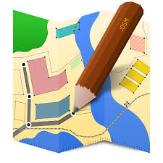

Introduction to JOSM

Slide 2
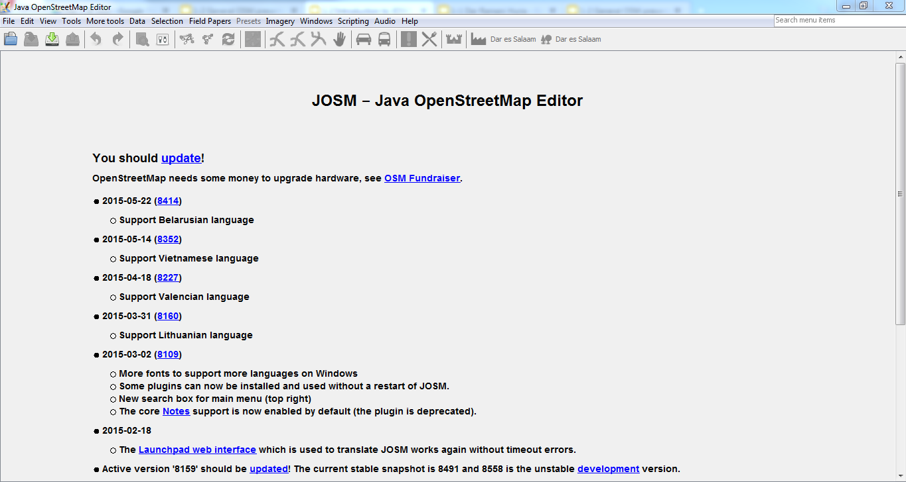
What is JOSM
Open source OpenStreetMap editor, written in Java
Works on offline data, only synced by the user (download data/upload), so data usage is limited

Slide 3
Install JOSM
Get a copy from the USB Stick from the facilitator. Copy the “JOSM install” folder.
Install the Java runtime (jre-8u45-windows-i586.exe)
Install JOSM
Open a file explorer window
Type %APPDATA% in the location bar
Copy the “JOSM” folder to this directory. This will install plugins.
Type C:\ProgramData in the location bar
Copy the “JOSM_presets” folder to this directory. This will install the presets.
Launch JOSM.

Slide 4
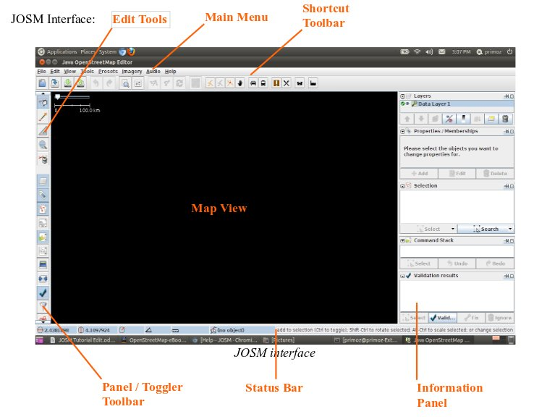

Slide 5
JOSM Interface
Map View – The main window where the geodata is displayed and editing takes place
Main Menu – The menu is customizable depending on which plugins you have installed
Shortcut Toolbar – The buttons in this toolbar are shortcuts to commands from the Main Menu. This toolbar is highly customizable, with the ability to add and remove menus items from the preference dialog.

Slide 6
Edit Tools – Contains drawing tools and the show/hide buttons for the Toggle Dialogs window
Information Panels – These show information about the data in JOSM, including a list of selected features, objects, how the selected objects are tagged, who the last mapper to edit a feature was, and the different layers in the view
Status Bar – Gives coordinates and measurements for features, as well as a hint of the current tools

Slide 7
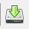
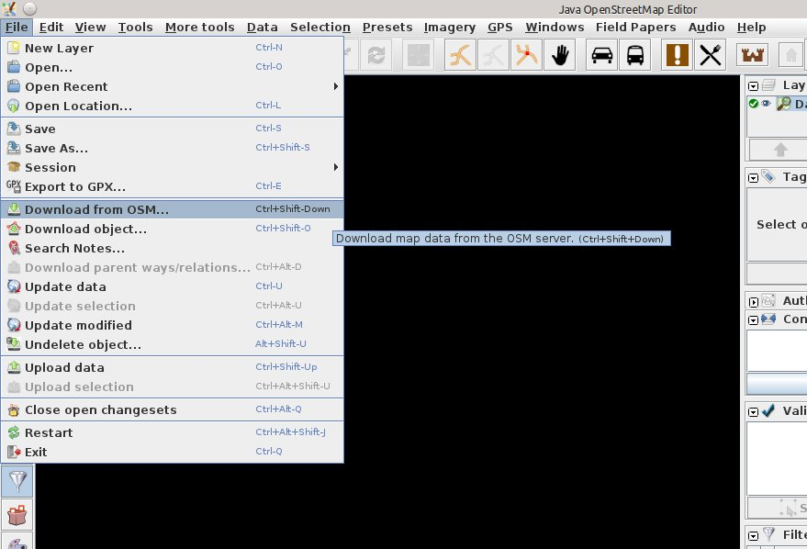
Click File > Download from OSM (or the icon on the Main Toolbar)
Downloading Data into JOSM from OSM Servers

Slide 8
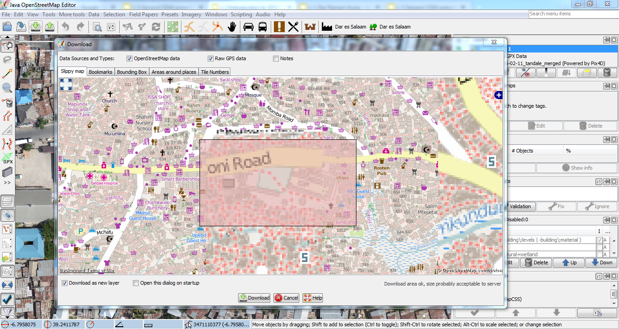
The download dialog box appears (Slippy Map)
Hold your left mouse button, drag to create a light pink box. This will be the data that will be downloaded into JOSM.
NB: Don’t download large portions of data because it may take a long while. Work with smaller portions, and after you’re done, you download another portion. You can always choose to download additional data!

Slide 9
Installing aerial imagery into JOSM (Mbtiles)
Run JOSM on your computer (Start Menu>Search>JOSM)
Collect mbtiles from supervisor (on memory stick), save your drive
Whats are Plugins?
These are tools that are not installed with JOSM by default, but can be installed later on to add more functionality to JOSM to help you accomplish a given task. They are downloaded manually by user.

Slide 10
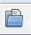
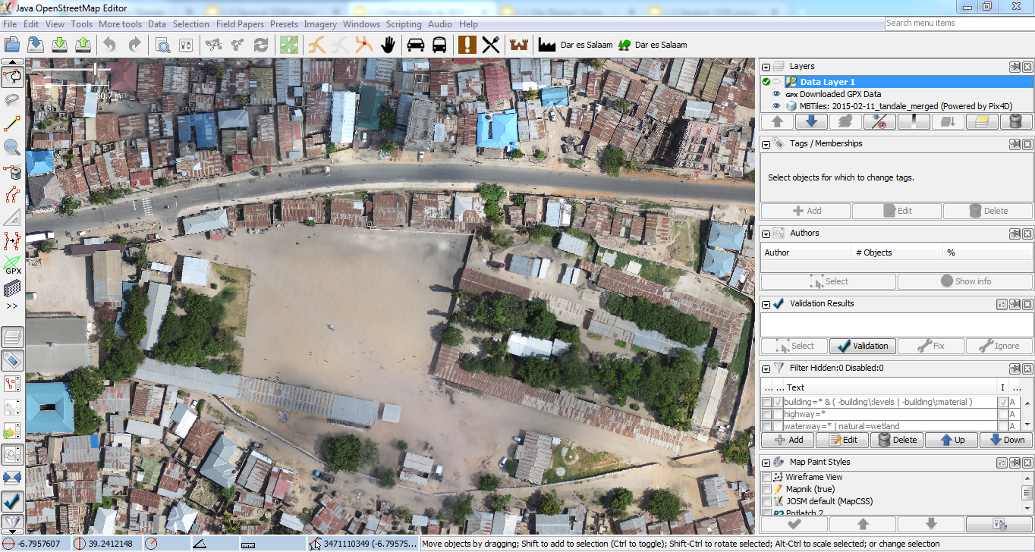
On the top menu, click on file>Open (ctrl + O)
Navigate to the location for mbtiles on your drive. Example:
Open file

Slide 11
Note: At times you may need to import your data to have the Mbtiles loaded into the Map Window. Just incase they don’t open instantly

Slide 12
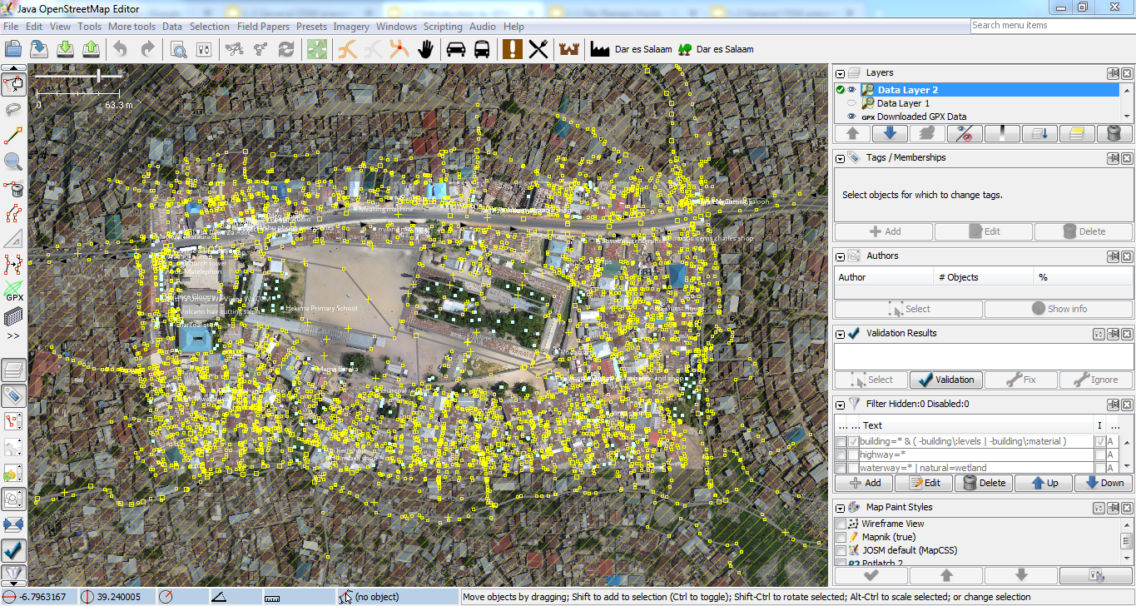
Press the button
Download Data should appear in the main Map View Window
The cross hatched area is to remind you that you should not edit outside the area that you download from the server.

Slide 13
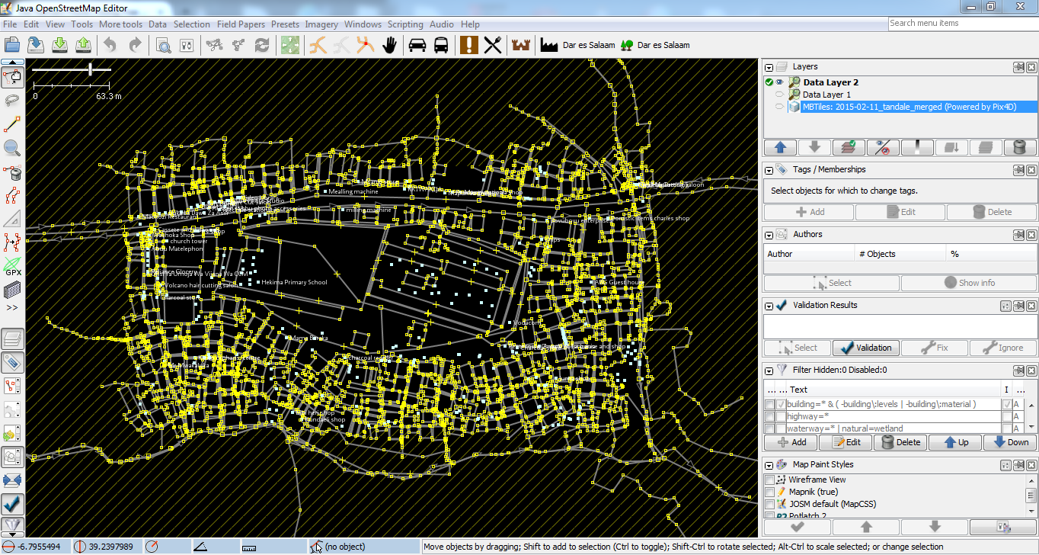
Downloaded data in JOSM
You can activate and deactivate the visibility of any layer, change the order of alignment, increase and decrease its transparency, merge a previously downloaded layer with a new one (Data Layer 1 and Data Layer 2 into one layer), Duplicate Layer and Delete.

Slide 14
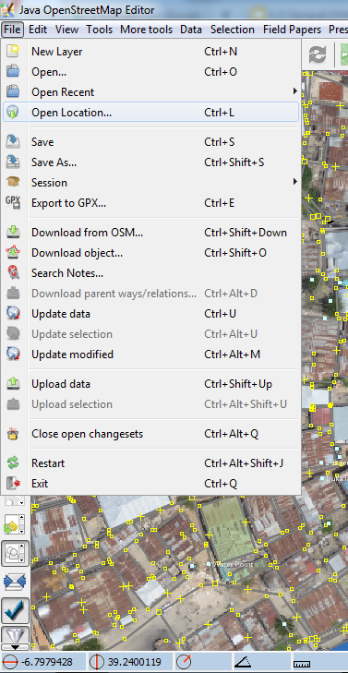
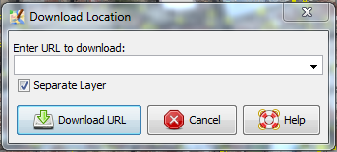
Downloading Data from OSM
There are other ways to specify the area you want to download:
Download data by pasting the url from OpenStreetMap site into JOSM File>Open Location or Ctrl + L

Slide 15
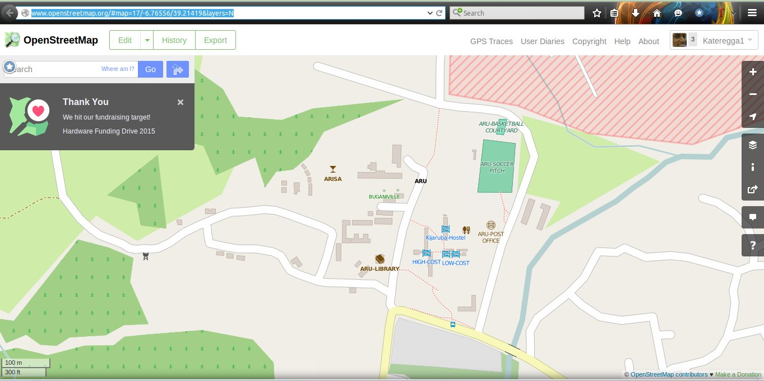
Copy the URL

Slide 16
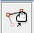
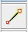
Once downloaded
Basic navigation:
Right mouse button: drag the map
Left mouse button: manipulate an element
Scroll wheel: zoom in/out
There are three main modes of operation when editing:
(S)elect
for selecting elements, viewing/editing their tags and moving them.
(A)dd
for adding elements, such as standalone nodes, adding new nodes to create a new way, or extend an existing way.

Slide 17

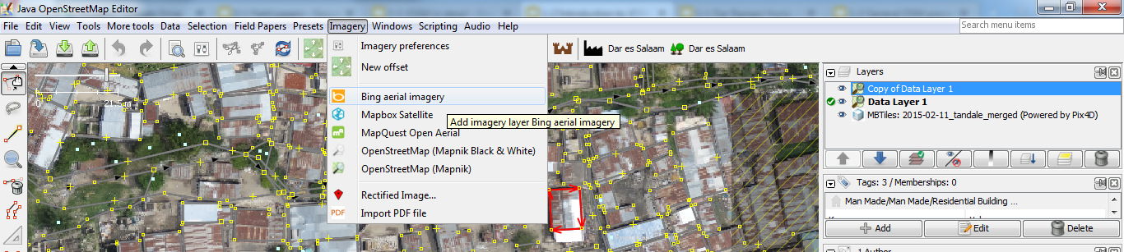
Delete (Ctrl+Delete)
for deleting elements.
Importing Imagery into JOSM
If you can’t access Mbtiles for a certain area, there are other means of accessing aerial imagery with the use of satellite imagery. (Bing is widely used)

Slide 18
Drawing basic elements
Nodes: The dots that are used to mark specific locations or for drawing the segments between these locations. Nodes are points in space. Each node has a latitude and longitude
Ways: An ordered list of nodes, displayed as connected by line segments. They are used to describe roads, paths etc
Closed Way or Area: Closed ways are ways which go in a closed loop. Used to describe areas (like parks, lakes, islands or buildings).

Slide 19
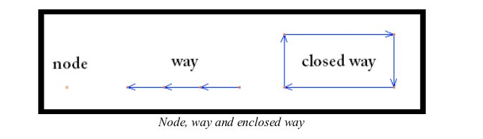
Drawing basic elements

Slide 20

Drawing a node
To draw a standalone node:
Clear your current selection by pressing Edit > Unselect All or press Escape button on your computer
Press 'A' or select the Draw Nodes to begin drawing a node
Press the Left Mouse Button somewhere in the Map View Window and press Escape
Double Click to create a node
Return to Select mode

Slide 21
Drawing a way (2)
Press again somewhere and another node will appear, joined by the first segment of a way
Keep pressing to draw a way with several nodes and segments on it
To stop go back to Select mode or press 'S' or Escape button on your computer

Slide 22
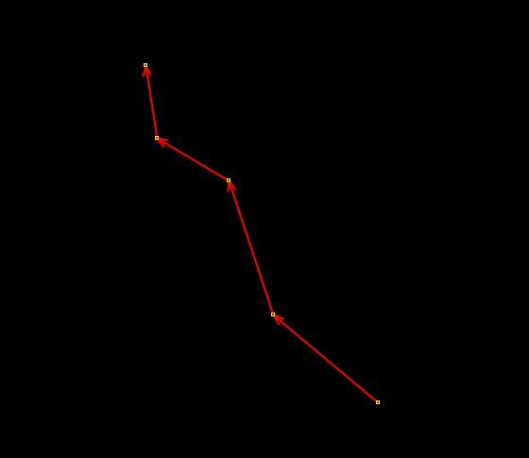
A way

Slide 23
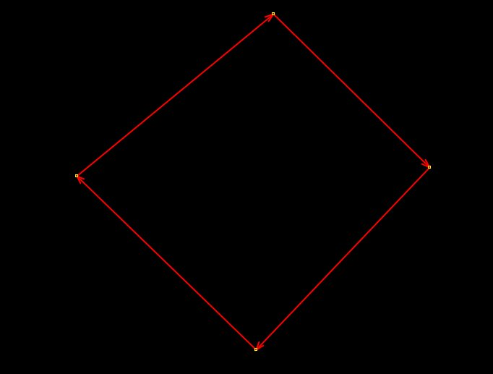
A closed way

Slide 24
Tags describe geographic data in OpenStreetMap.
Tags are attributes (or descriptions) you attach to basic elements (nodes, ways, closed ways/areas)
A Tag is a Key = Value pair
Key is a string describing the general classification of the feature. The Value gives more specific information within the class Key
Keys and generic Values are lower case and do not including space, use underscore instead.

Slide 25
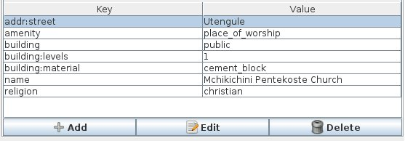
Tagging
In JOSM tags are displayed on the right side under “properties/memberships”. Selecting an element displays the table with key and value fields
Tags for a selected object

Slide 26
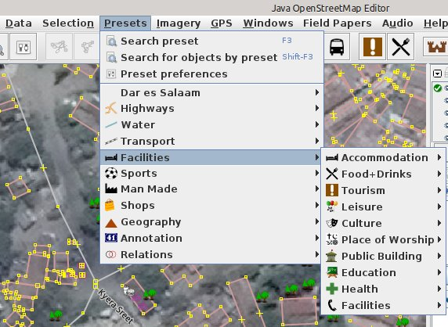
Presets
A preset is a tag that is given a “human-readable”name. Presets allow the user to tag objects by selecting them from the predefined menu.
In JOSM go to
Main Menu
and press
Presets

Slide 27
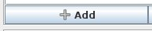
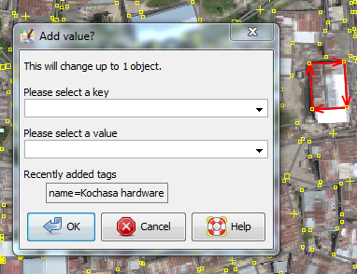
Presets/Tag
Add a tag by using an “Add” button:
Press the button Add a Tag
Change values window appears where you can select a key or a value from the drop-down list. The drop-down list contains all the values in the downloaded area and all the know tags or presets. Add a tag by using predefined

Slide 28
Presets
Select an entry from Presets by pressing Presets tab on the Main Menu
Select an entry from the drop-down
Select the attributes
Press Apply Preset

